Slide 1
Digital Portfolio
STUDENT NAME:M.sandhiya
REGISTER NO AND NMID: 81A988E47F4BDEBB2A74071F25D5D63B
DEPARTMENT: Bsc Cs with Ds
COLLEGE: Tagore college of arts and science

Slide 2
PROJECT TITLE
“Innovations in Healthcare for a Better Tomorrow”

Slide 3


AGENDA
Problem Statement
Project Overview
End Users
Tools and Technologies
Portfolio design and Layout
Features and Functionality
Results and Screenshots
Conclusion
Github Link
3/21/2024 Annual Review

Slide 4

PROBLEM STATEMENT
The healthcare sector faces significant challenges in delivering accessible, affordable, and quality care to all individuals. Rapid population growth, shortage of healthcare professionals, unequal distribution of medical resources, rising treatment costs, and the burden of chronic diseases create barriers to effective healthcare delivery. Additionally, limited use of technology, poor data management, and lack of awareness among patients hinder timely diagnosis and treatment. These issues result in health inequalities, delayed care, and reduced overall public health outcomes.

Slide 5

PROJECT OVERVIEW
This project focuses on understanding and improving the healthcare system by exploring its structure, challenges, and innovations. The aim is to highlight how healthcare services can be made accessible, affordable, and efficient for all sections of society. The project covers different aspects such as public and private healthcare systems, digital healthcare solutions, emerging technologies, and the role of government policies. It also examines issues like rising healthcare costs, shortage of professionals, and unequal access to medical facilities. By analyzing these factors, the project proposes sustainable solutions and modern approaches, including the adoption of telemedicine, Al, electronic health records, and preventive care strategies, to ensure better health outcomes for individuals and communities.

Slide 6

WHO ARE THE END USERS?
Second user persona (example: patient, doctor, government, insurance provider)?Second use case of healthcare technology?Or do you need a second project overview/statement for healthcare in a different style?

Slide 7

TOOLS AND TECHNIQUES
1. Electronic Health Records (EHRs) - Digital systems to store and manage patient data.
2. Telemedicine Platforms - Virtual consultation tools for remote healthcare delivery
3. Wearable Devices - Smartwatches, fitness bands, and medical sensors for monitoring health (e.g., heart rate, BP, glucose).
4. Artificial Intelligence (AI) & Machine Learning - Used for diagnosis support, predictive analytics, and personalized treatment.
5. Robotic Surgery Systems - Advanced robotic tools for precision in surgeries.
6. 3D Printing - For creating prosthetics, implants, and customized medical devices

Slide 8
POTFOLIO DESIGN AND LAYOUT
1. Cover PageTitle: Healthcare Portfolio / Project NameSubtitle: Improving Healthcare through Innovation & TechnologyYour Name, ID/Reg. No, Institution, DateRelevant Healthcare image or logo
Design TipsColors: Blue, Green, White (professional & health-related)Fonts: Clean sans-serif (like Arial, Roboto, Calibri)Icons: Use medical icons (heartbeat, syringe, cross, hospital)Layout Style: Minimal, infographic-based, easy-to-read
8

Slide 9
FEATURES AND FUNCTIONALITY
1. Patient Registration & Management - Store personal details, medical history, and appointments.
2. Electronic Health Records (EHR) - Digital record of patient health, lab results, and prescriptions.
3. Appointment Scheduling - Online booking, reminders, and doctor availability management.
4. Telemedicine & Remote Consultations - Virtual doctor visits for remote healthcare access.
Functions
Improved Patient Care - Quick access to medical history, faster diagnosis, and better treatment.
Efficiency in Operations - Streamlines hospital workflow, reduces paperwork, and saves time.
Enhanced Communication - Between doctors, nurses, patients, and other healthcare staff.

Slide 10
GitHub link
https://github.com/ssandhiya1548-commits/My-Portfolio-.git

Slide 11
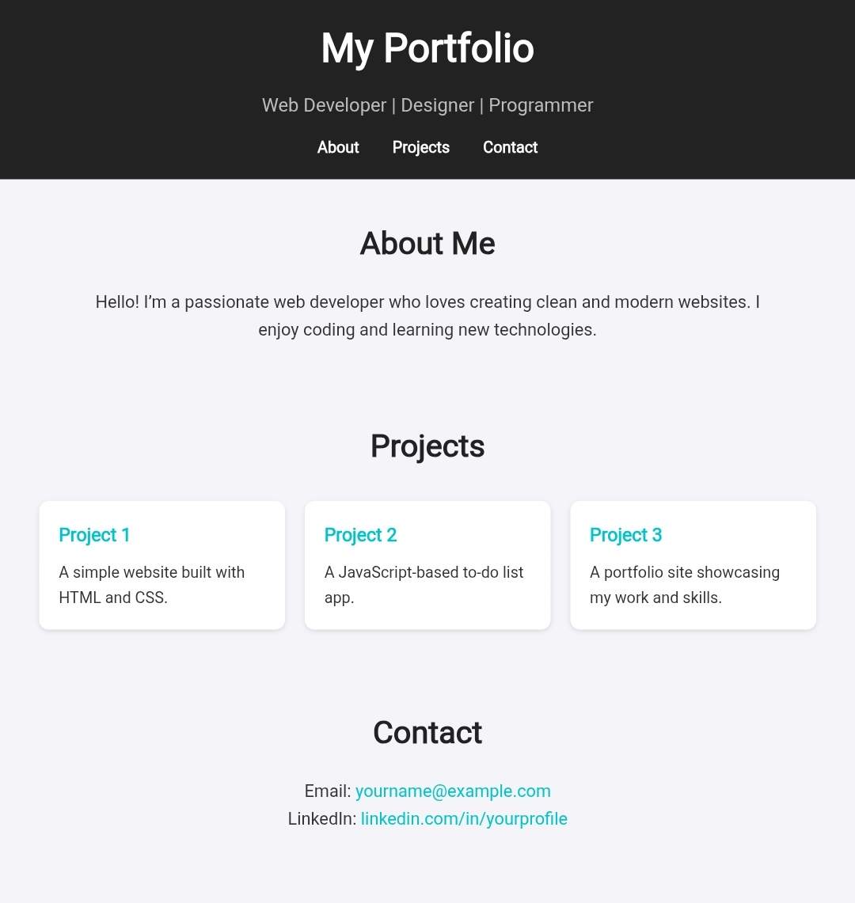

RESULTS AND SCREENSHOTS
3/21/2024 Annual Review
11

Slide 12
CONCLUSION
Healthcare is a vital sector that directly impacts the well-being of individuals and communities. Modern healthcare systems, supported by digital tools, advanced technologies, and efficient management practices, aim to provide accessible, affordable, and quality care for all. By integrating innovations such as telemedicine, Al, electronic health records, and wearable devices, healthcare can overcome challenges like resource shortages, unequal access, and rising costs.Effective communication, data-driven decision-making, and preventive care further enhance patient outcomes. The future of healthcare lies in smart, technology-driven solutions that ensure timely treatment, improved efficiency, and better overall public health.
12

